Slide 1
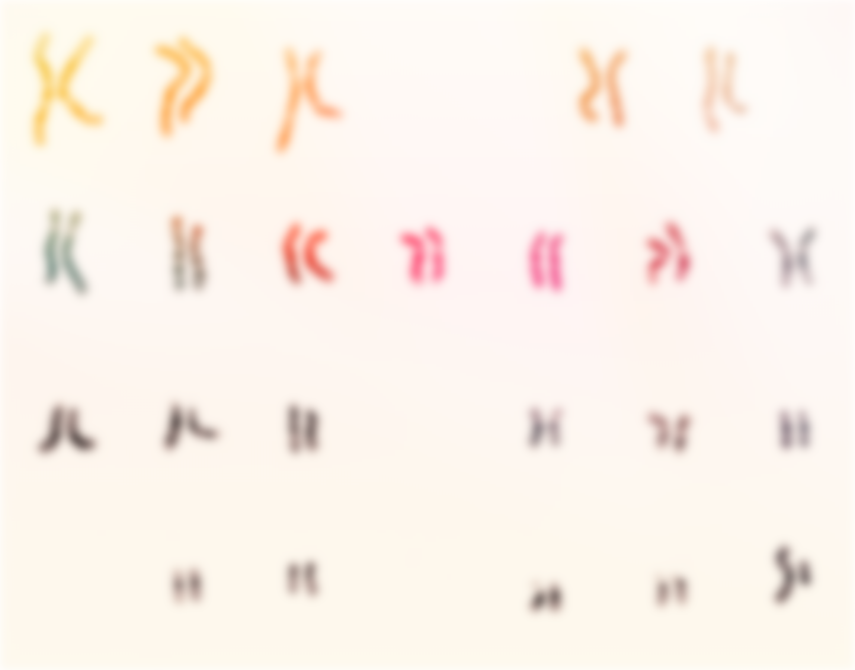
Bioinformatics analysis of structural variant breakpoints in fragile sites across different cancer types.
Hamish Bultitude @ QIMR Berghoffer - Ann-Marie Patch

Slide 2
Structural Variant
noun
ˈstrʌkʧərəl ˈveərɪənt
A substantial change of the DNA structure, anywhere from 50 base pairs changes or greater. These involve deletions, insertions, inversion, and either interspersed or tandem duplications of DNA, accounting for 1% of total genomic variation, 10x more than SNPs
(Alkan et al., 2011), (Tattini et al., 2015).

Slide 3
Fragile Site
noun
ˈfræʤaɪl saɪt
An area of DNA where there is a high density of breakpoints, where DNA is likely to form gaps when during times of replication stress when in metaphase of cell division, often involving long genes or areas of extensive nucleotide repetition
(Ma et al., 2012) (Feng et al., 2017)

Slide 4

Lets zoom in on our DNA

Slide 5
1. DNA separates
DNA

Slide 6
2. DNA replication begins?
DNA
DNA REPLICATION STALLED

Slide 7
Normal Genome
(Eisenstadt, 2012)

Slide 8
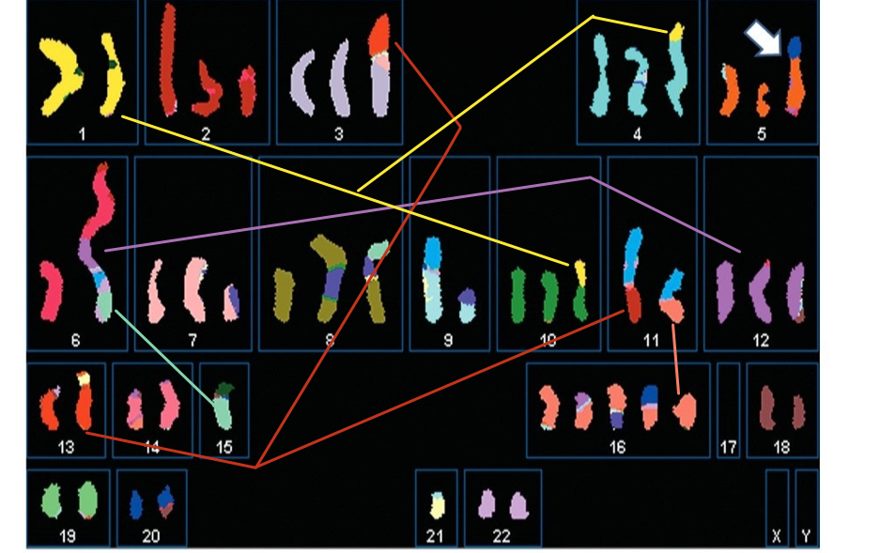
Cancer Cell Genome
(Karp et al., 2015)

Slide 9
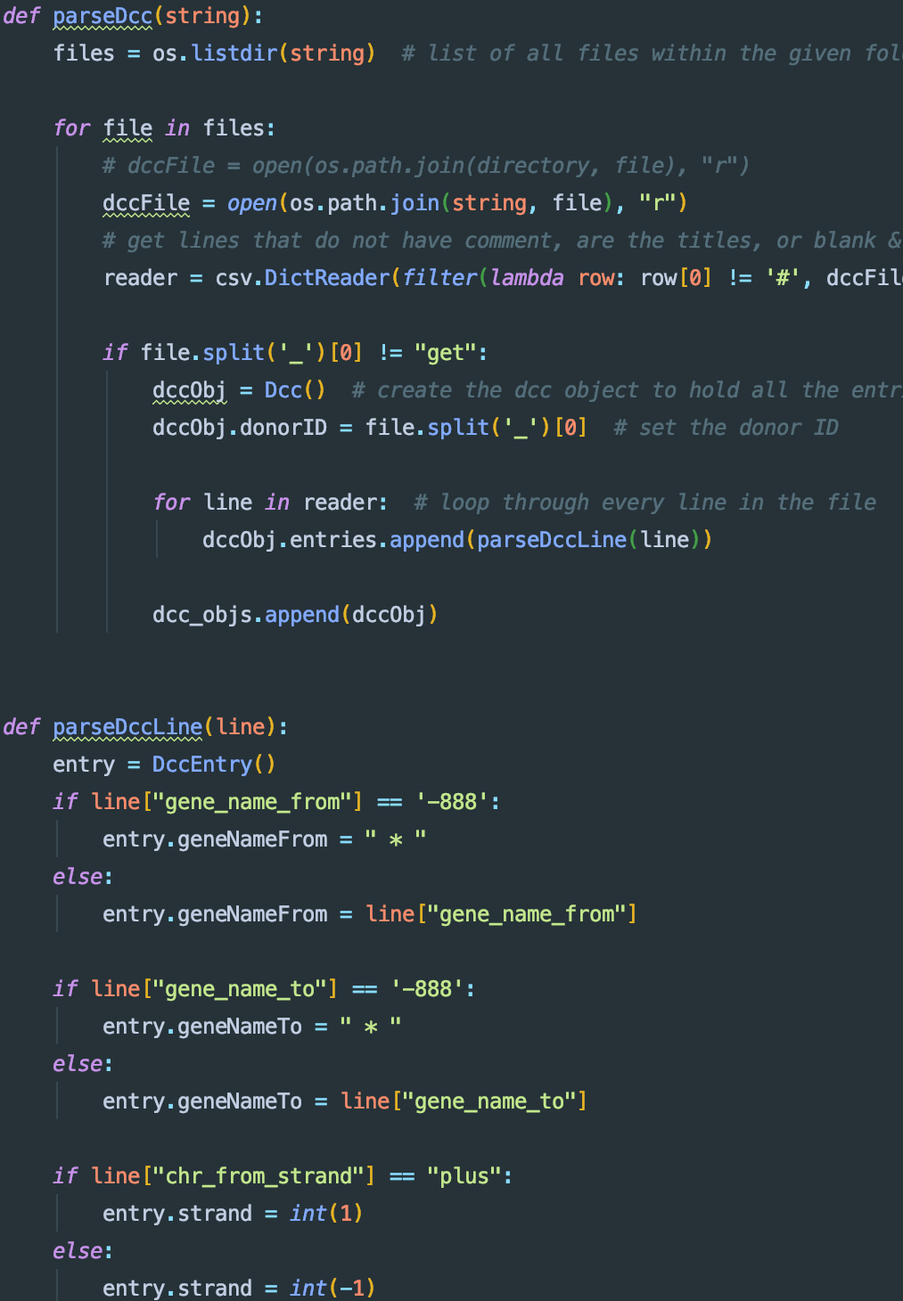
Project Aims
Create a programming pipeline that allows for the adaptive scanning and analysis of breakpoint files for multiple cancer types
Create graphs that summarised this performed analysis
Determine features of particular cancer types and utilise these differences to compare features of cancers.

Slide 10
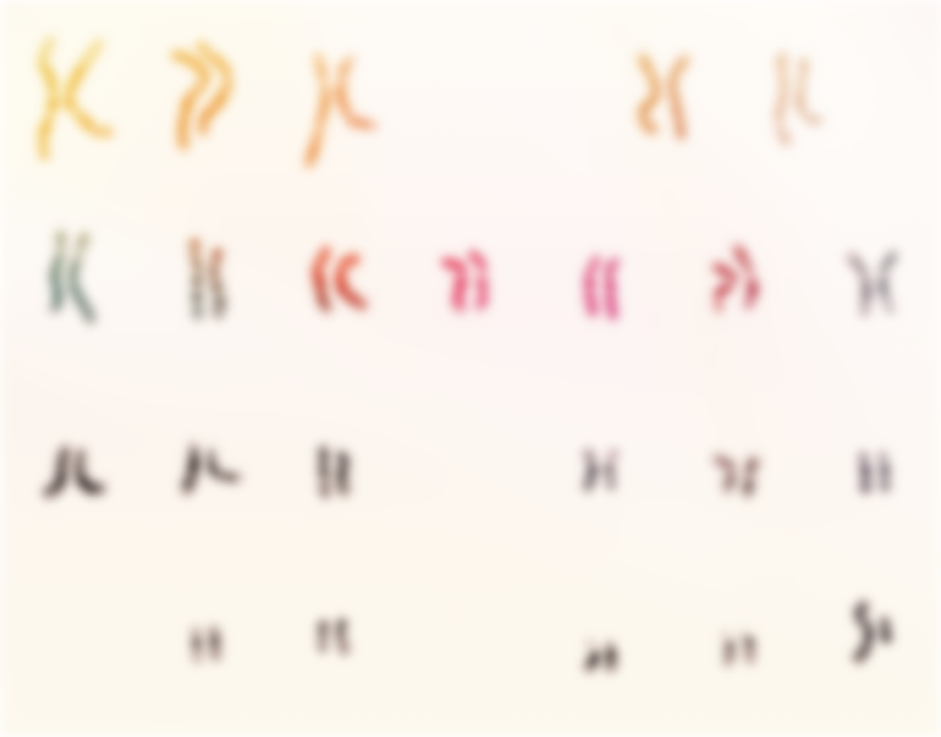
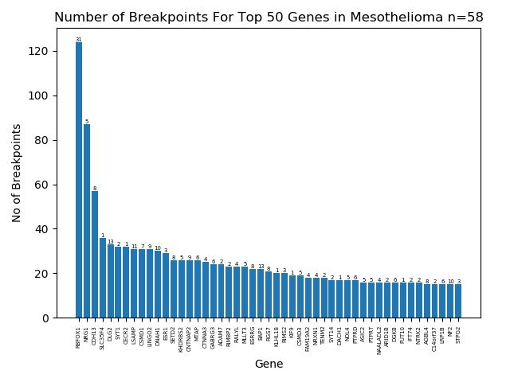
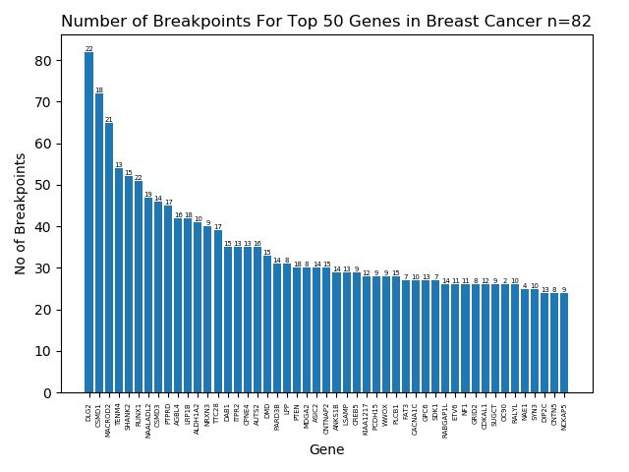
Top 50 Genes in Mesothelioma
RBFOX1 gene very common in donors!!!
wider spread of gene breakages
Top 50 Genes in
Breast Cancer

Slide 11
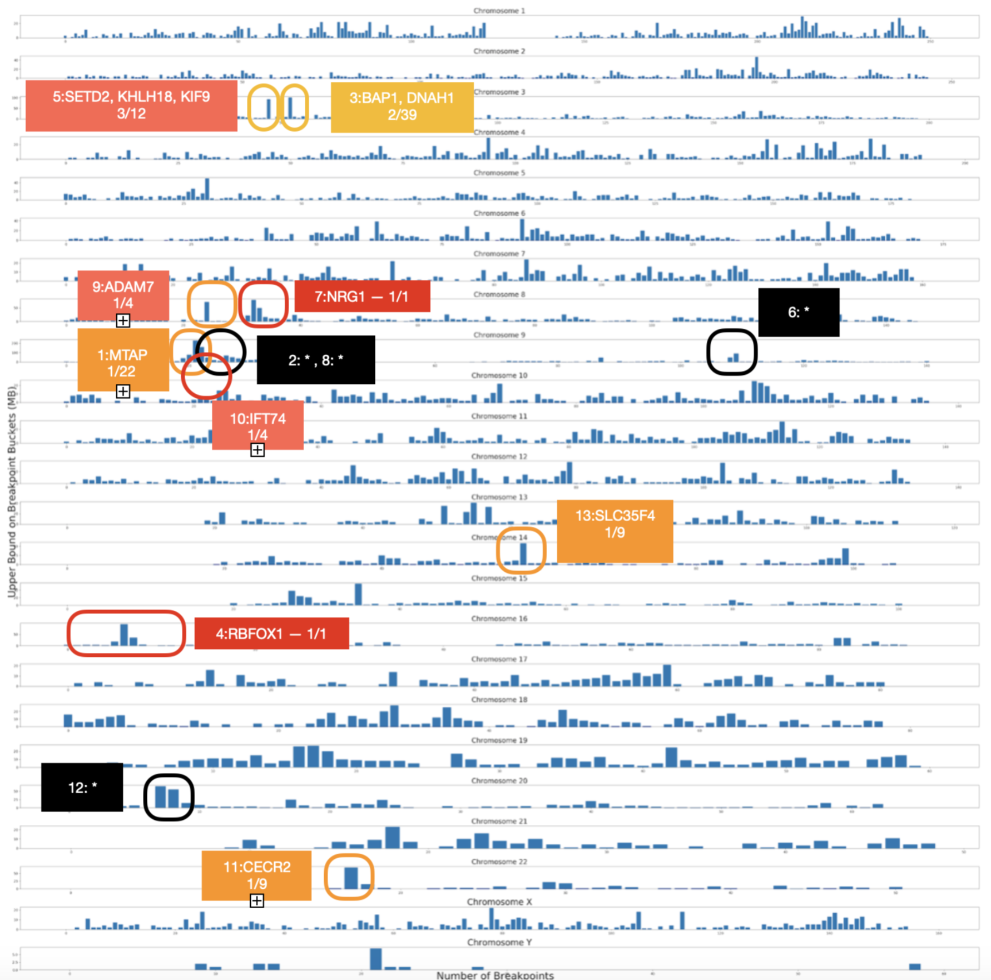
Identification of frequently broken sites of Mesothelioma

Slide 12

Length vs Breakpoint Mesothelioma
Percent of Protein Coding Genes by Length | Number of Top 50 Breakpoint Genes
10% | 39/50
5% | 37/50
2.5% | 32/50
1% | 24/50
Percent of Protein Coding Genes by Length | Number of Top 50 Breakpoint Genes
10% | 46/50
5% | 45/50
2.5% | 44/50
1% | 38/50
breast cancer has more long genes broken than mesothelioma
Length vs Breakpoint
Breast Cancer

Slide 13
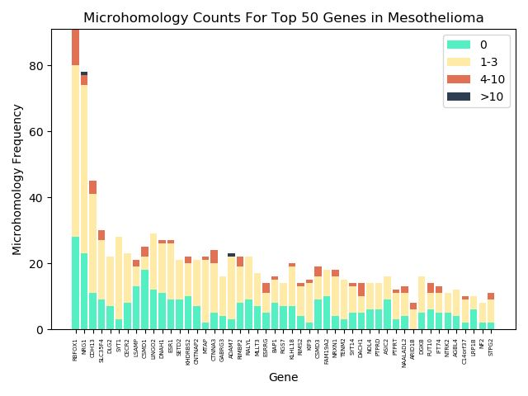
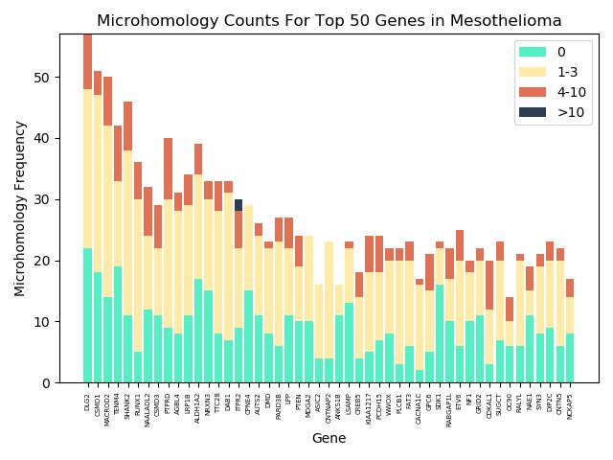
Microhomology Plot Mesothelioma
Microhomology Plot
Breast Cancer

Slide 14
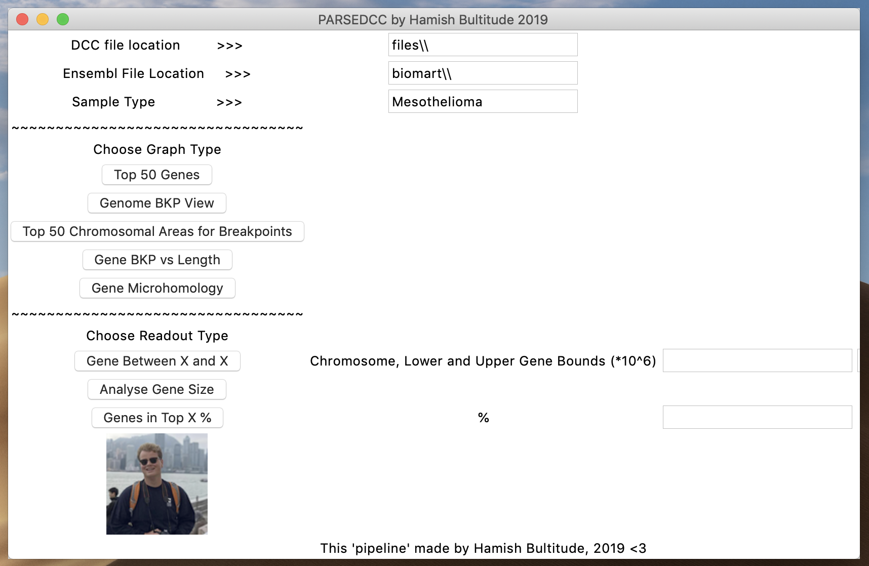
“to be continued…?”
GUI made to interface with parseDCC

Slide 15
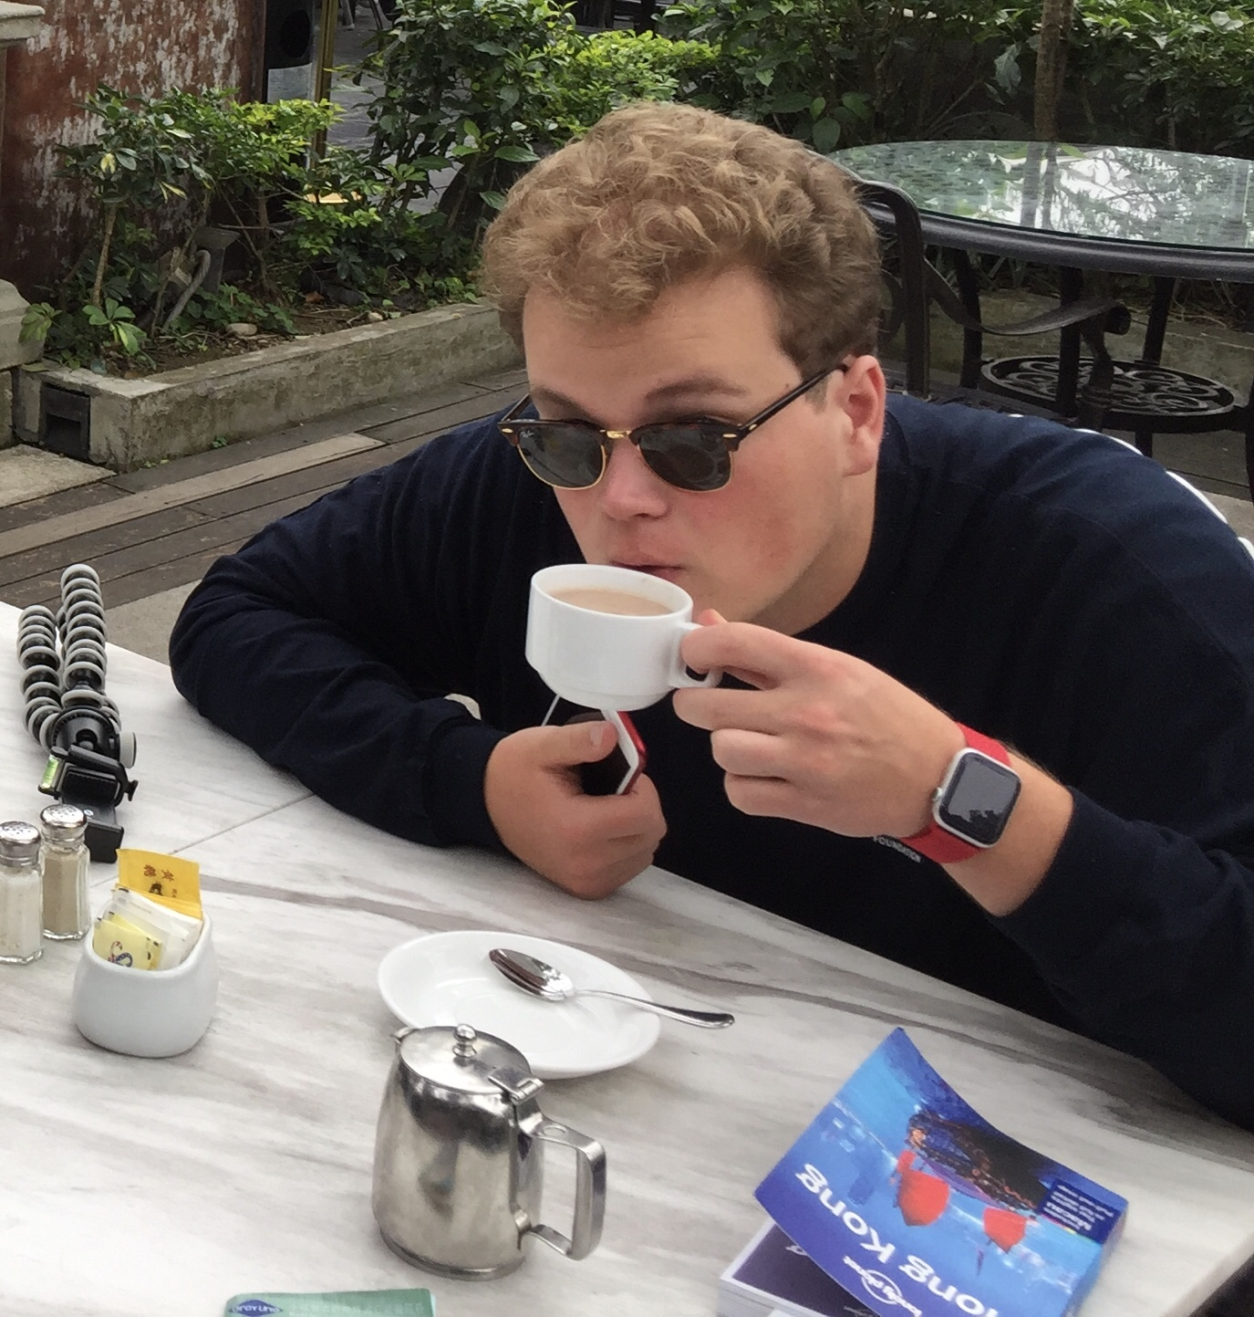
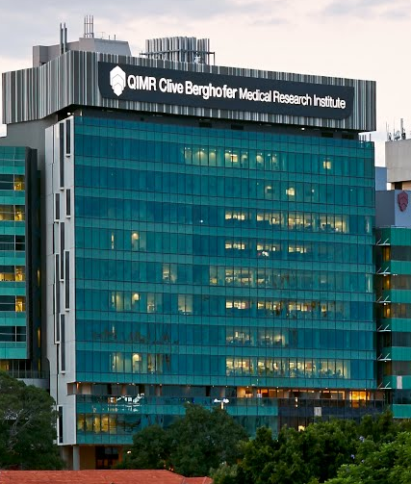
Thank you for Listening!
If you have further questions or need something programmed, feel free to contact me at my UQ email address or number:
H.Bultitude@uq.net.au
0432 832 796

